Slide 1
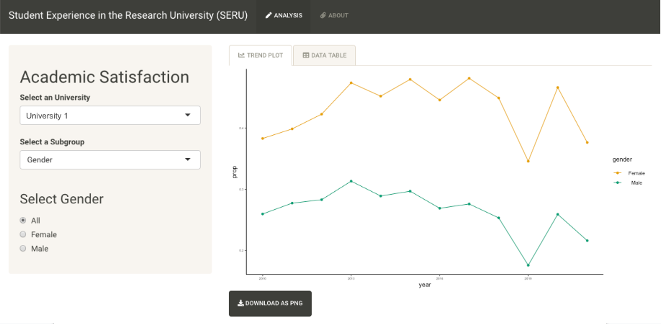
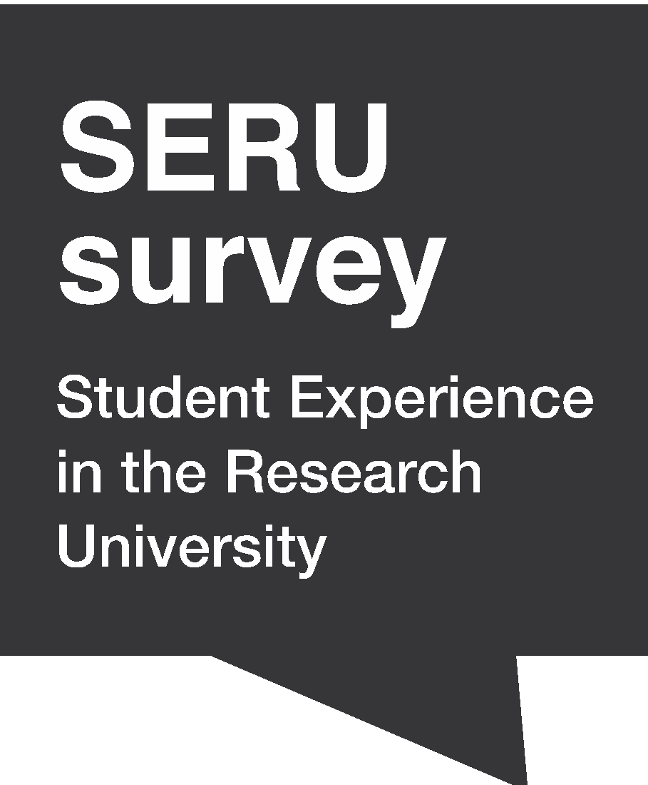
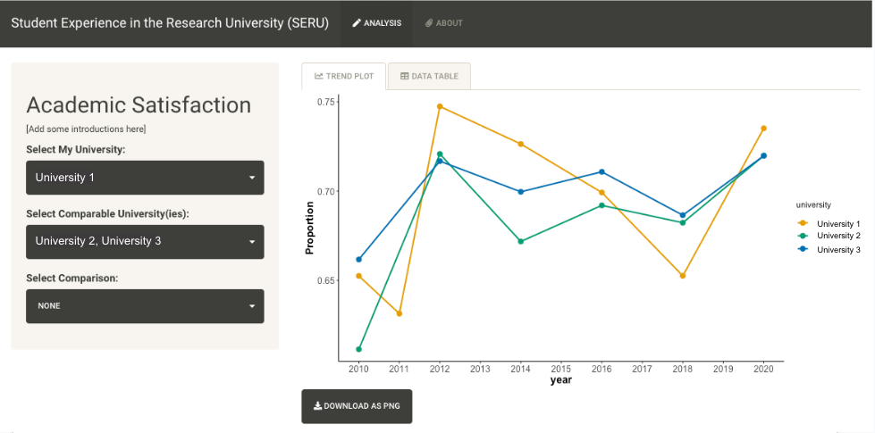

Undergraduate Overall Academic Satisfaction in the U.S. Public Research Universities: Evidence from the 10 Years of SERU Survey Data
INTRODUCTION
OBJECTIVES
Shiny App 2: Within University View
Our project is looking to investigate the U.S. undergraduate students' overall yearly academic experience at public research universities in a 10-year trend. With millions of survey responses and administrative records collected from the undergraduate students during 2010-2021, we are hoping to shed light on future academic-related public research university policy to improve various aspects of students' academic satisfaction.
As a team, we are looking to create a Shiny App visualization interface for stakeholders and policymakers to view data visually with multiple metrics and lay the foundation for future visualization in different scopes in this project.
Show overall yearly academic satisfaction of undergraduate students at the U.S. public research universities across 10 years with SERU survey data.
Build an interactive data visualization report on Shiny App for stakeholders and policymakers to view the survey results visually.
SOLUTION: SHINY APP
On the Shiny App, audience can select their topic of interest and view the undergraduate data visually across different U.S. public research universities and their demographic data comparison within one university. With the topic of interest determined, they can select their home university and other universities that they wish to compare with. They can also select comparison parameters in terms of demographic information.
With all the comparison criteria selected by the audience, the Shiny App is capable of generating a visualization accordingly to show the 10-year trend in the scope of the topic of interest. Both the trend plot (PNG file) and the comparison data (CSV file) are downloadable from the Shiny App for future reference.
We develop two different views of the dashboard in our Shiny App. Shiny App 1 has a view across different universities. It allows audiences to compare academic satisfaction between their home university and other universities across years. Audiences can analyze how different policies, education, and behavior in universities could affect students’ satisfaction in different years.
Shiny App 2 has a view within a single university. Audiences can select a specific university and a subgroup category (eg. gender, ethnicity) that they want to explore. Audiences will be able to examine the overall trend of satisfaction in this selected university and also investigate the effect of different subgroup categories on students’ satisfaction.
DATA: SERU SURVEY
Sample: 1,000,000+ undergraduate student responses
Universities: 30+ public AAU/R1 partner institutions
Period: 2010-2021
Source: Student survey responses
Student Experience in the Research University (SERU) is a member-run, not-for-profit consortium of top tier research-intensive universities. More than 40 research universities partner with SERU. SERU survey focuses on various aspects of undergraduate experience: academic and research engagement, educational experiences, satisfaction, campus climate, major evaluation, academic and personal development, student mental health and wellbeing, and cost of attendance.
SInce we are working with survey responses, we are constantly dealing with inconsistencies in the questions asked. Questions or choices can exist in different format, but pretty much refer to the same things. Surveys also add or remove questions throughout the years, which means we are also dealing with missing values. To figure out the best way to address this, we think about for each variable, what is the most appropriate action for the missing values. Given the question we are trying to answer, we either choose to remove the null values or fill in 0.
VISUALIZATION
Shiny App 1: Across Universities View
CONCLUSION
The 10-year trend generated and analyzed from SERU survey data of undergraduate students’ overall yearly academic satisfaction at the U.S. public research universities shed light on future academic-related policy making for stakeholders and policymakers.
With the interactive report built on Shiny App, we can add in more topics of interest in terms of students’ experience in the partnered public research universities and refer to more aspects of demographic information from the administrative records collected.
The SERU survey data is protected under NDA. If you need any additional information, please contact us at chirikov@berkeley.edu. Thank you.

